Slide 1

Ice Crystal Roughness
In Cirrus Clouds
Tia Böttger and Rohan Crossland
Jake Price and Steven Neshyba’s lab group
Summer 2023
Notes:
https://whatsthiscloud.com/cloud-types/cirrus/

Slide 2
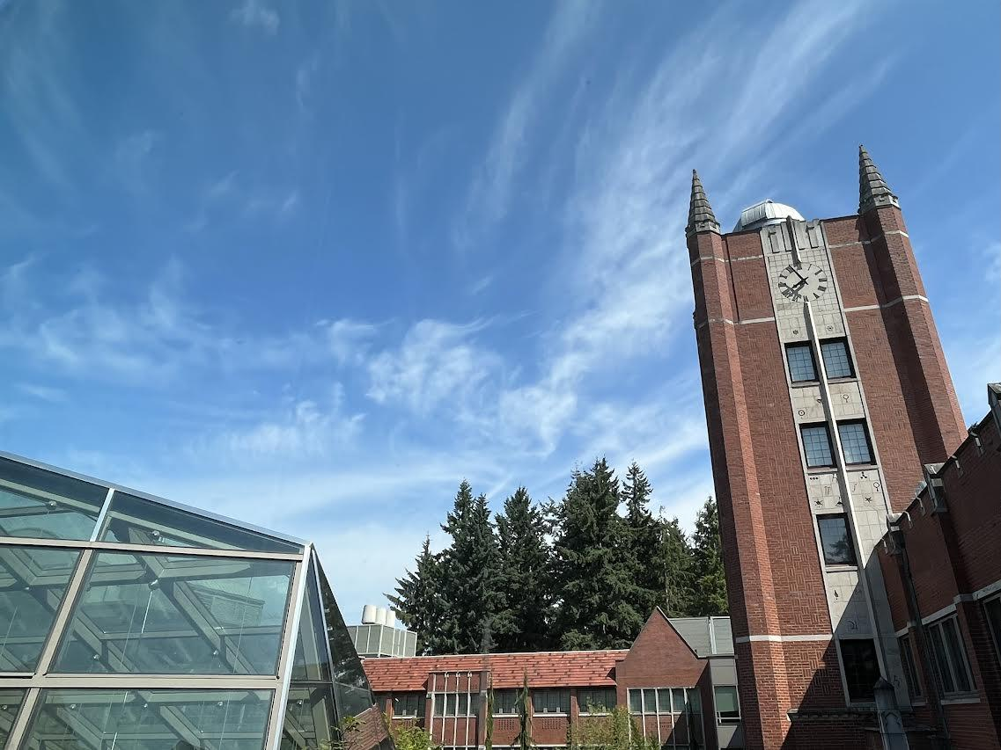

High altitude cirrus clouds are composed of ice crystals
Cirrus
Altitudes above 20,000 ft (6,000 m)
Temperatures below -20°C
Stratus

Slide 3

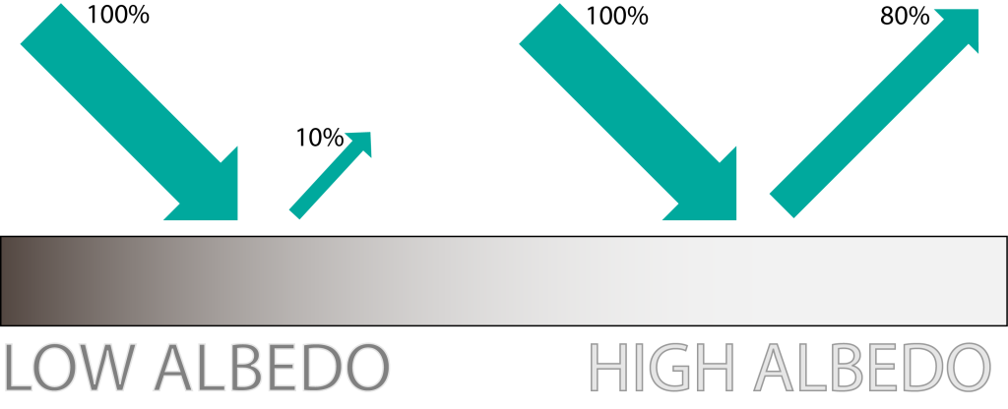
Cirrus clouds are important for climate modeling
Cirrus cover 30% of the globe (Wylie et al., 2005)
and 60–70% of the tropics (Sassen et al., 2009)
Earth’s average albedo is .30 (30% reflected)
Temperature is very sensitive to albedo
(1% albedo decrease = ~1°C temperature rise)
Notes:
https://www.essearth.com/why-albedo-is-important-for-our-melting-ice-caps/
https://whatsthiscloud.com/cloud-types/cirrus/

Slide 4
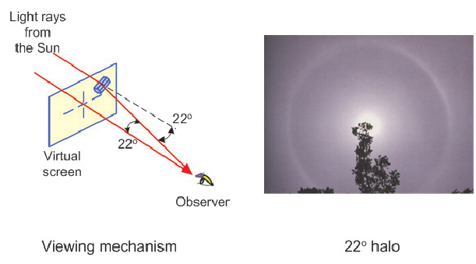
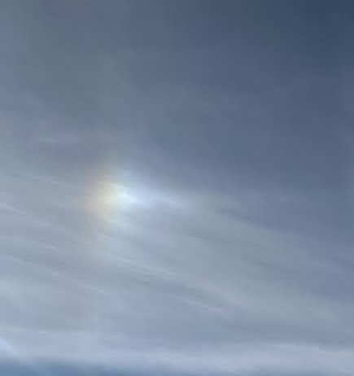
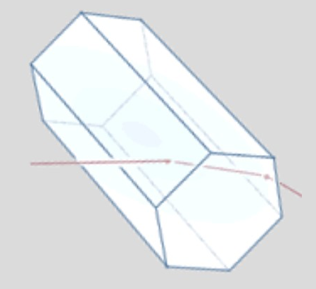

Ice crystal structure determines light scattering properties
22° halo
parhelion (sun dog)
Hexagonal prisms
Faceted growth
Not dendritic growth
(like snowflakes)
facets
Notes:
https://www.researchgate.net/figure/Light-pass-in-ice-crystal-and-parhelia-photo-redrawn-from-7_fig5_241591594
https://atoptics.co.uk/halo/circ1.htm

Slide 5
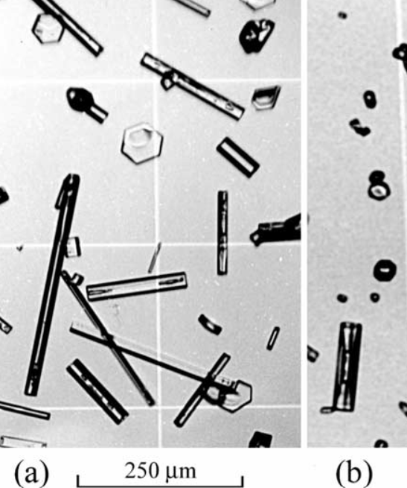
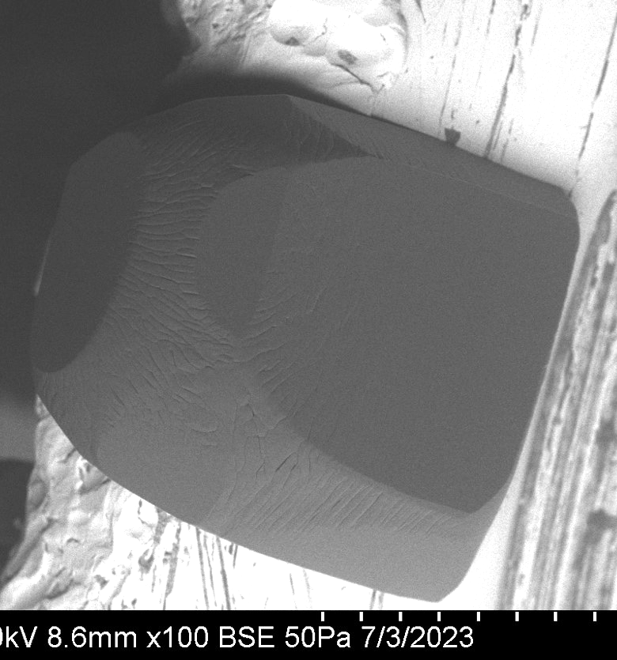
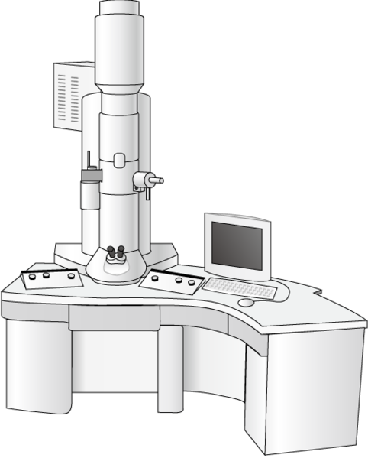
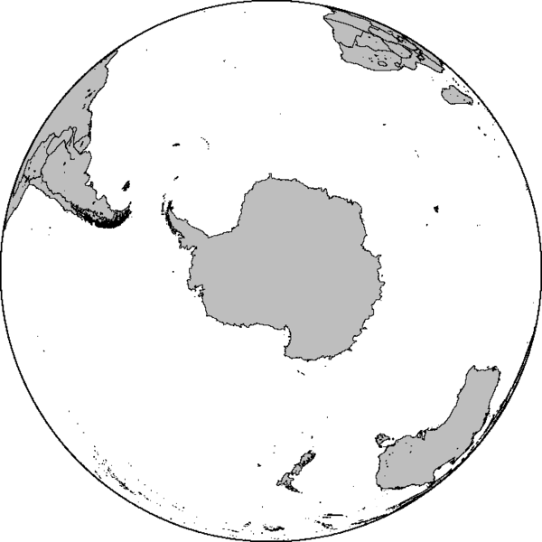

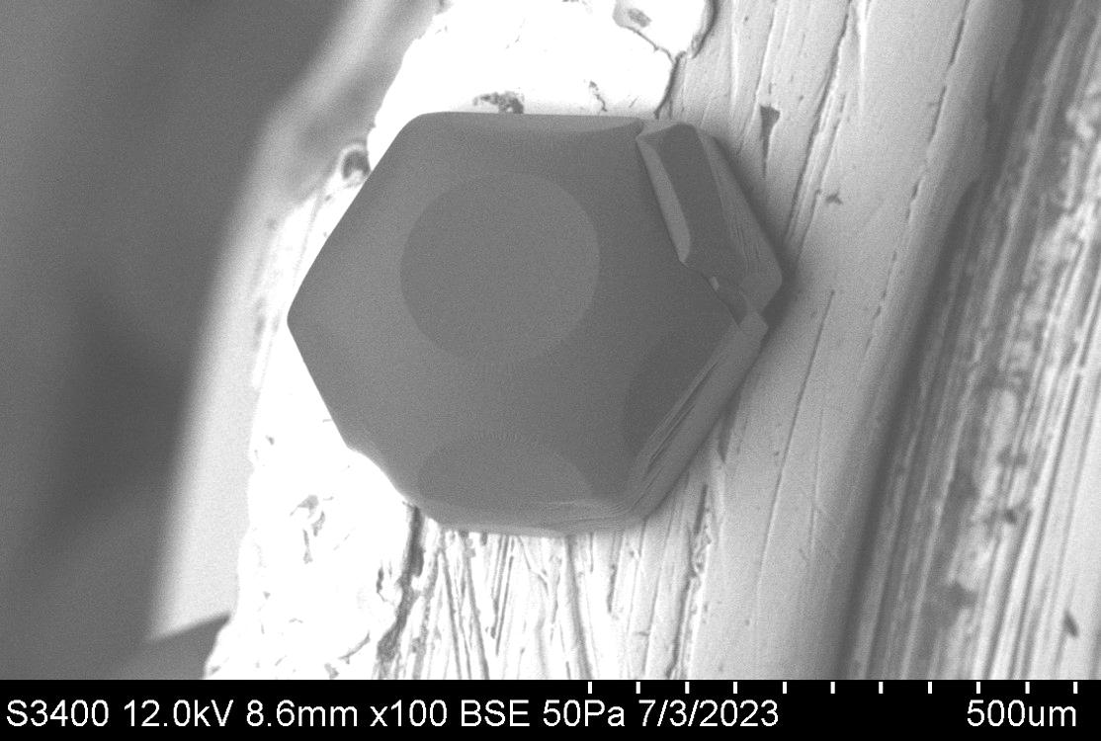
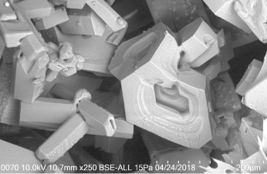

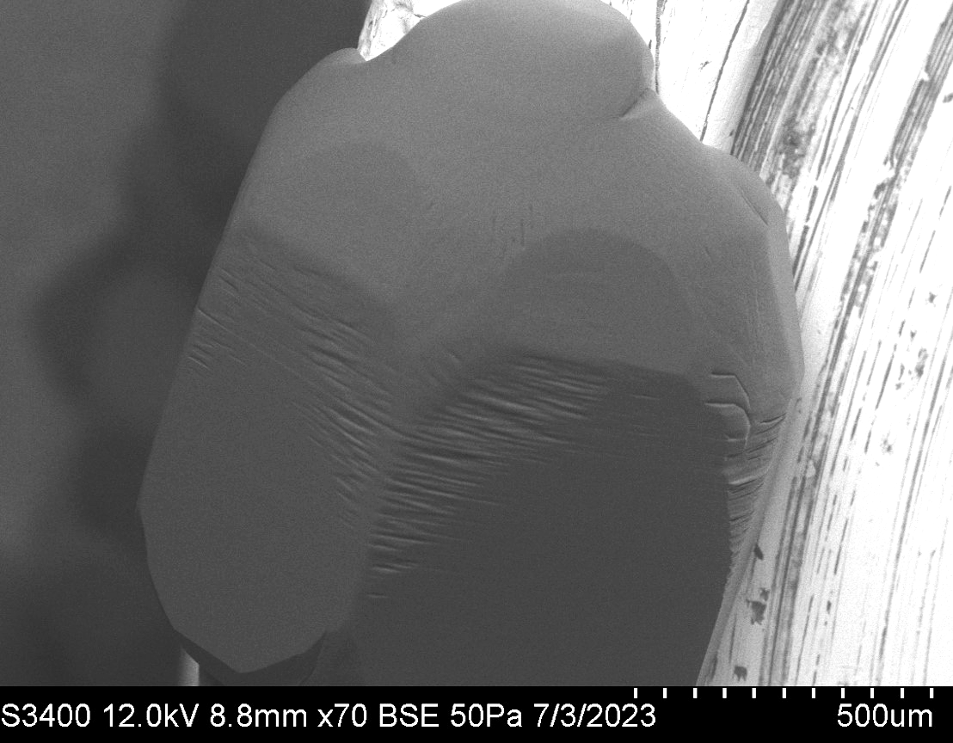
Atmospheric ice
Ice grown in lab (SEM)
Grenfell et. al 2005
Magee et. al 2020

Slide 6
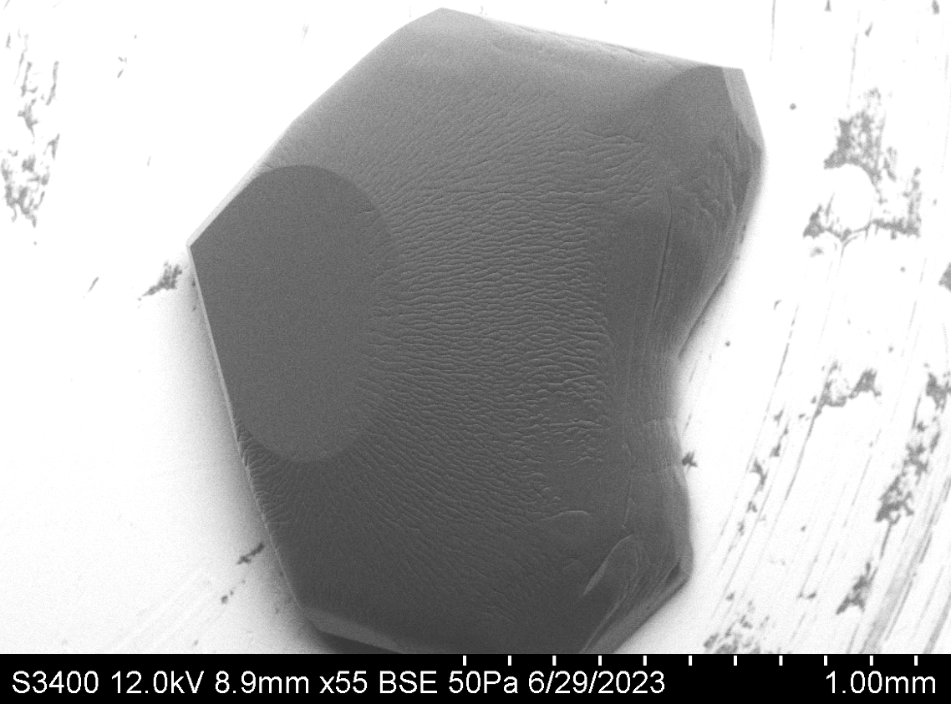
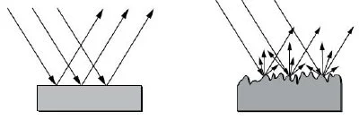
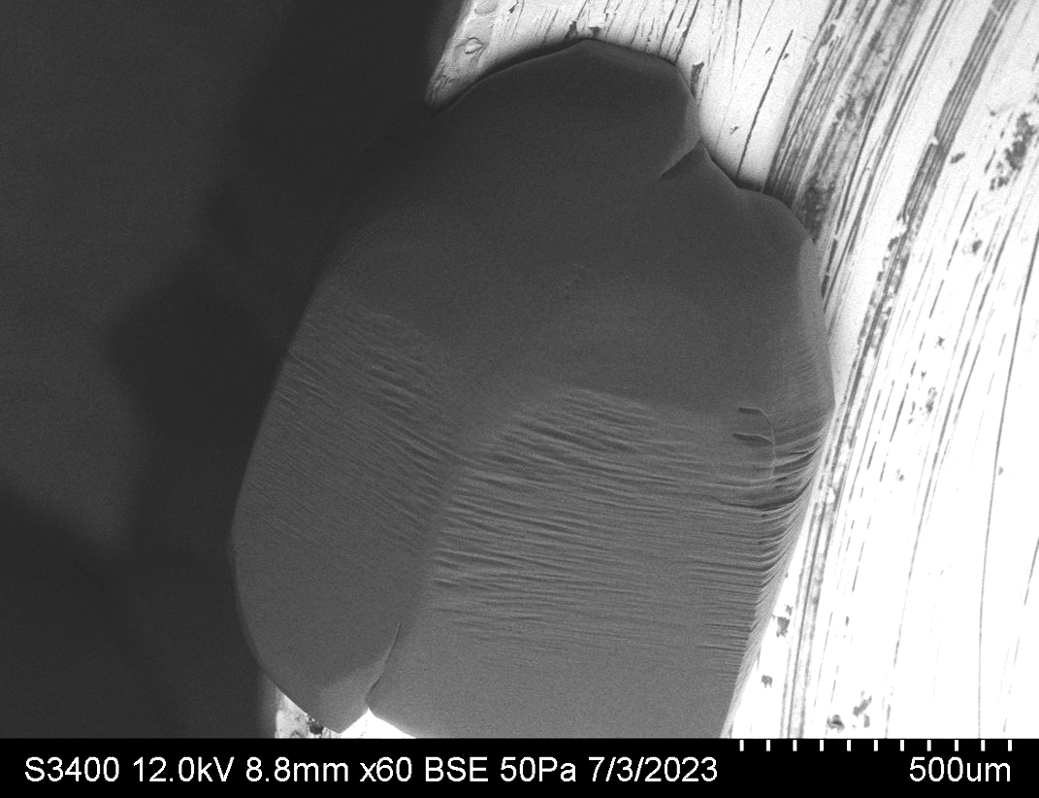
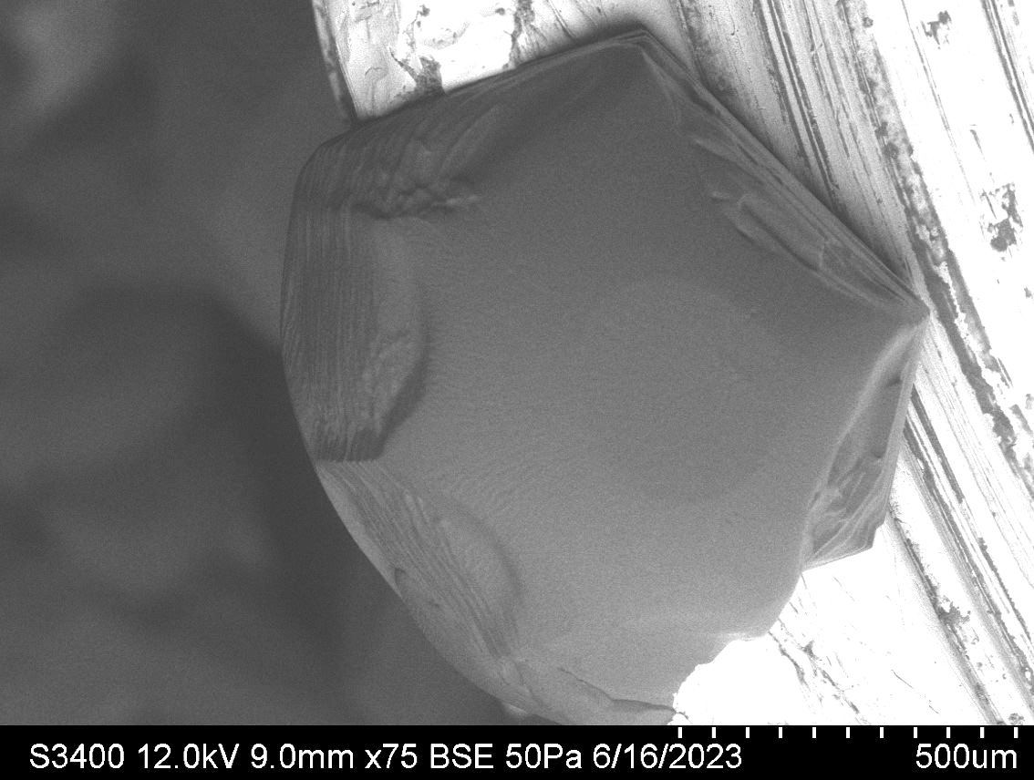
Microscale roughness and distortion increases reflectivity
Ella and Spencer working on mathematical model for roughness in prismatic facet
Notes:
https://www.azom.com/article.aspx?ArticleID=10617

Slide 7
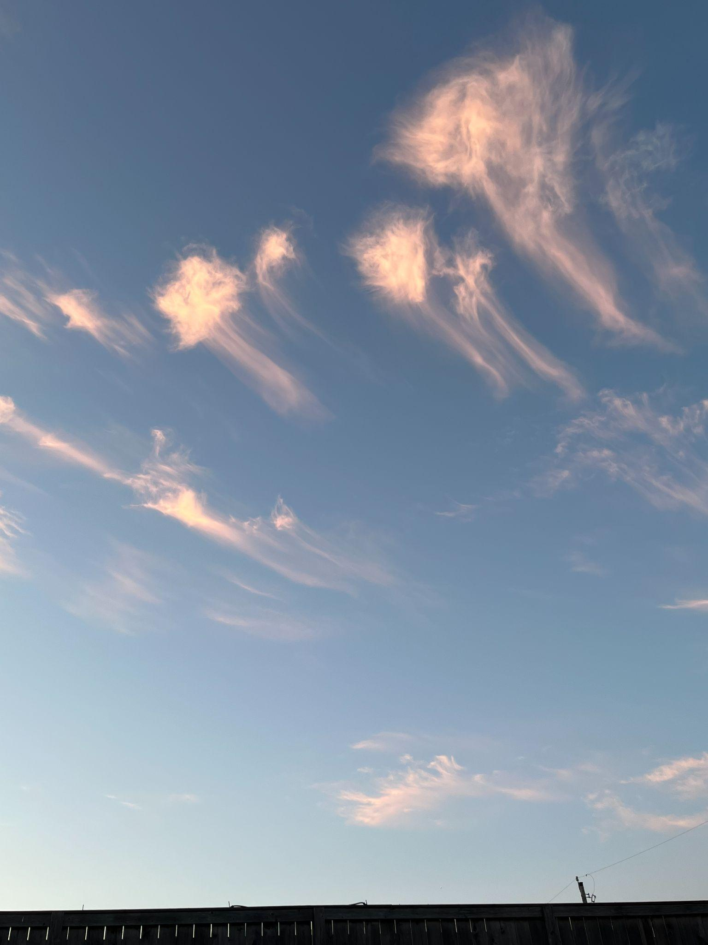
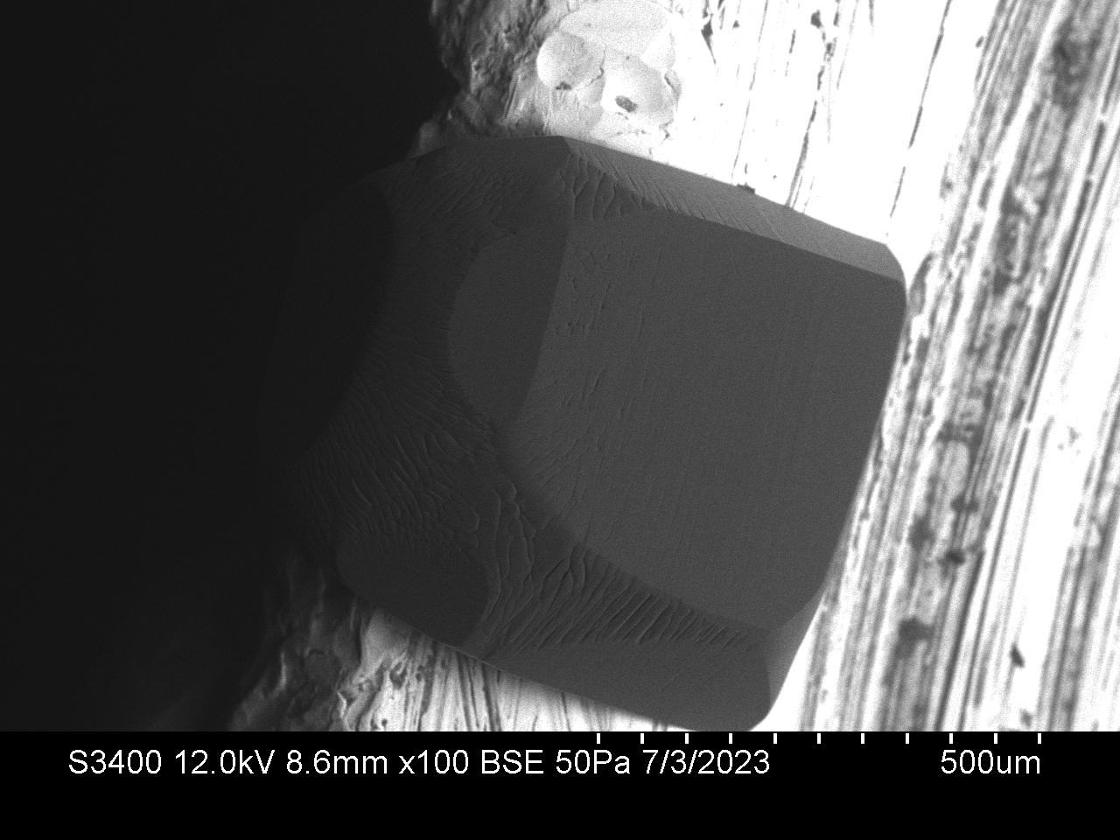
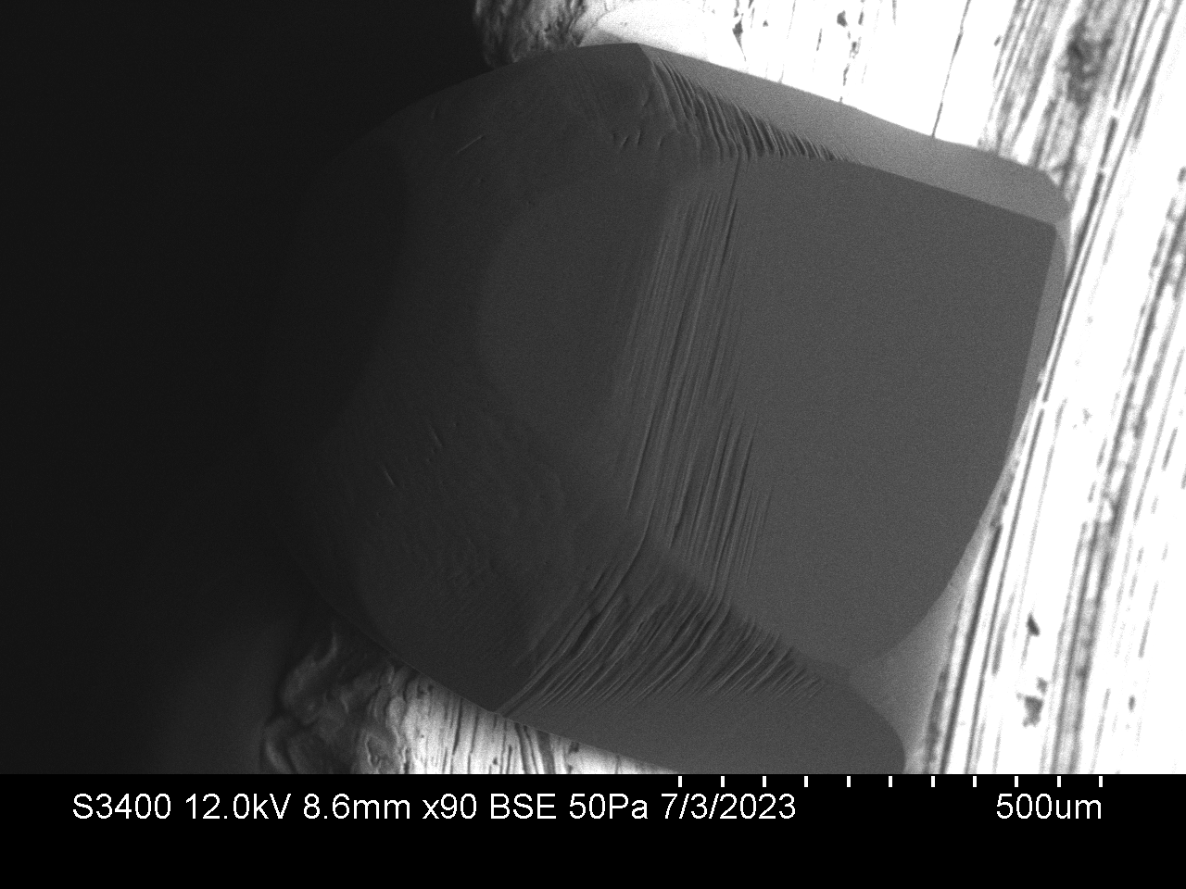
Cirrus ice crystals are exposed to changing conditions
Higher elevation (colder)
Growth roughness
(colder temp)
Increasing temperature
Ablation roughness
(warmer temp)
Lower elevation (warmer)
Comma-shaped cirrus clouds

Slide 8
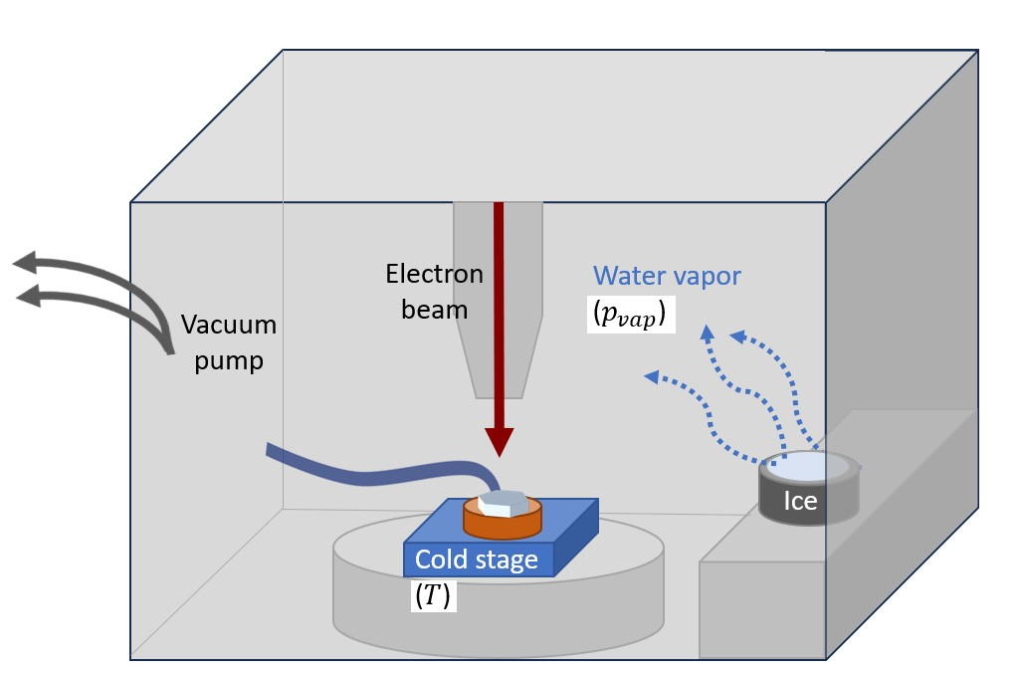
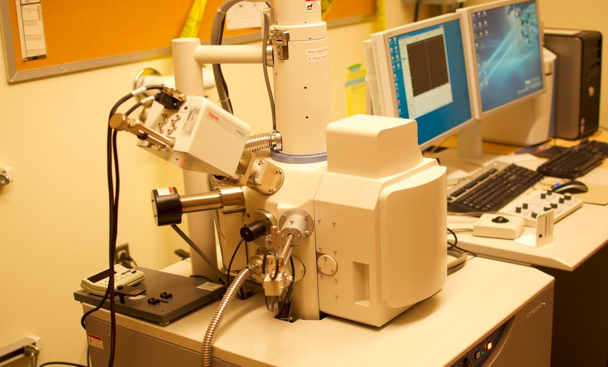
Hypotheses and Assumptions:
Scanning Electron Microscope (SEM) diagram
The ice crystals grown in SEM are a good proxy for those in cirrus clouds
Variations in temperature and vapor pressure can explain differences in shape and surface morphology (even quantitatively)
We can control temperature (T ) and vapor pressure (p_{vap} ) to mimic cirrus cloud conditions
Scanning Electron Microscope
Notes:
Add in pictures explaining shape and surface morphology

Slide 9
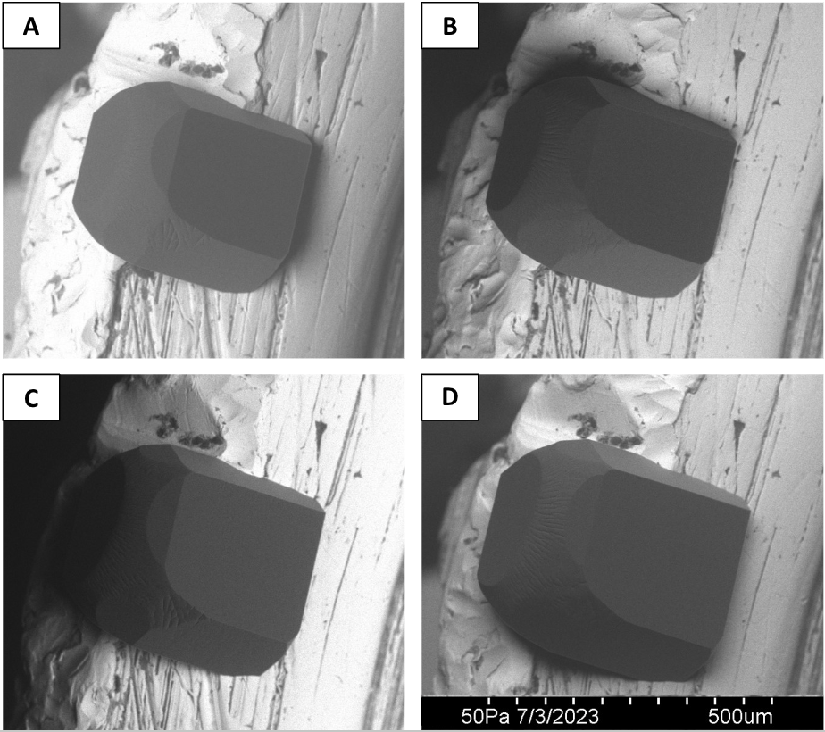
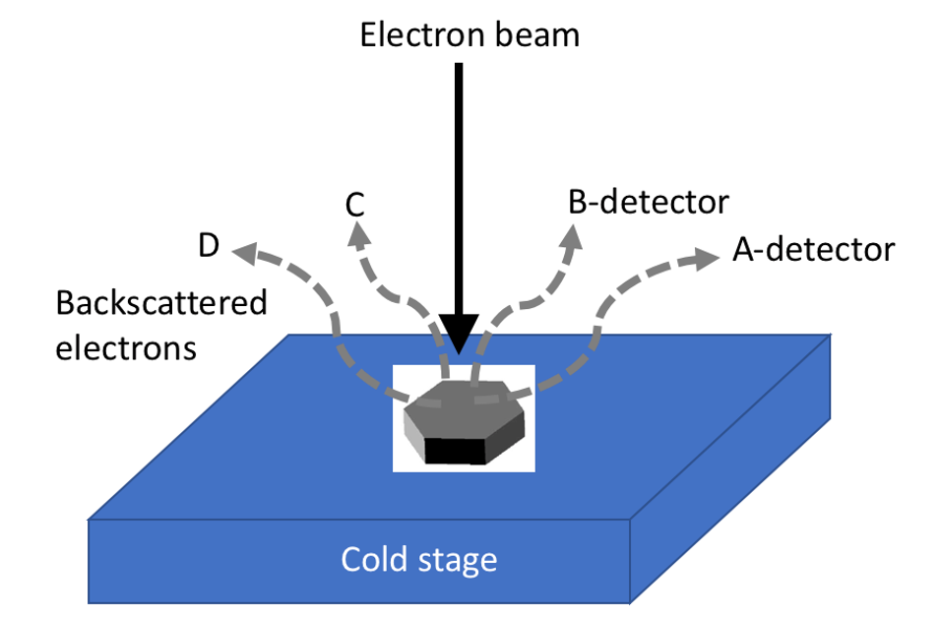
SEM utilizes 4 detectors to pick up on backscattered electrons

Slide 10
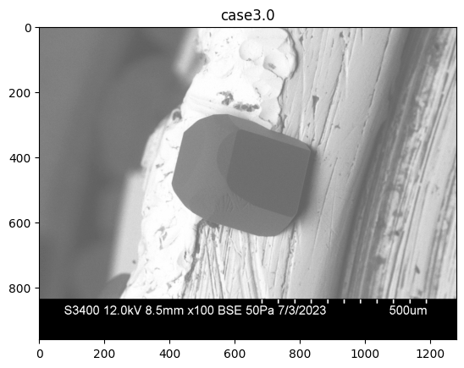
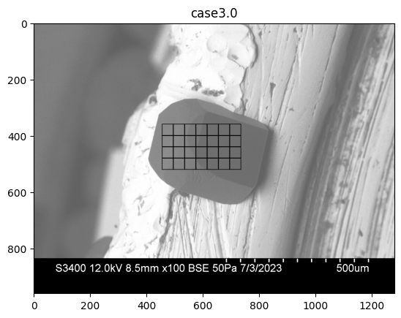
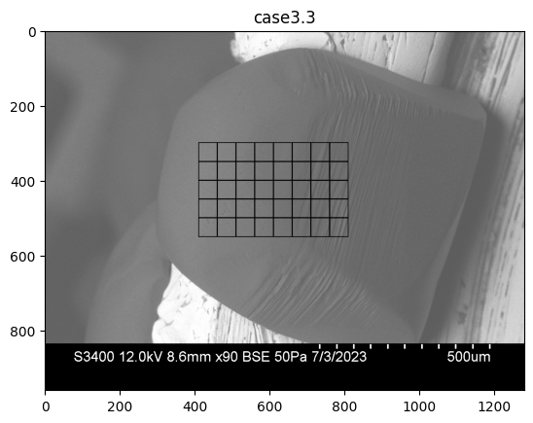
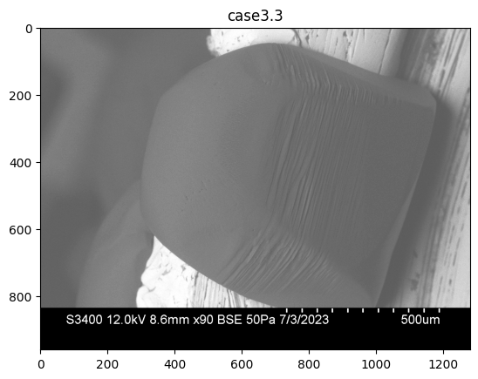
Data from the images can be extracted and used for 3D printing!
Pyramidal
Prismatic
Basal
Portions of a crystal’s surface, called segments, are drawn to highlight the area under analysis.
Notes:
Add labels for facets before the grids come in.

Slide 11
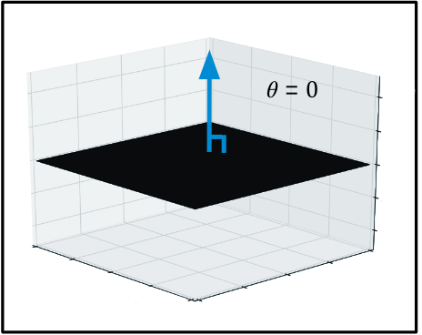
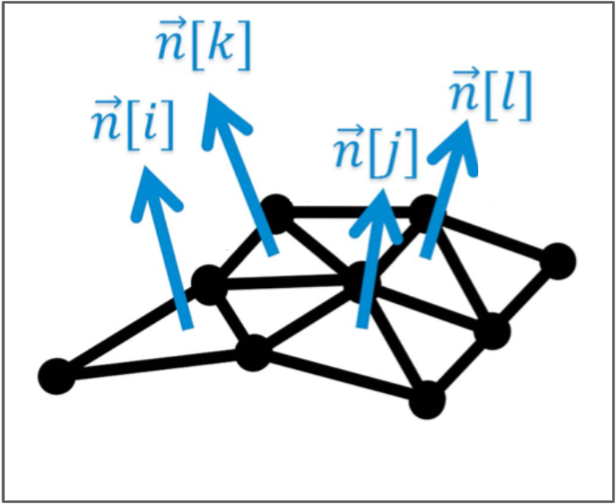
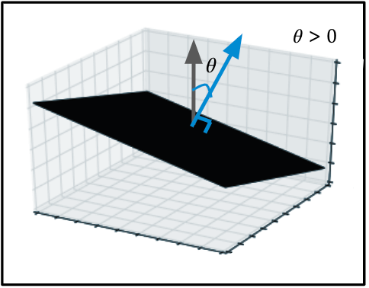
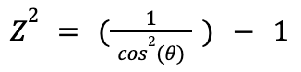
Segments are split up into pixels to be analyzed
Microsurface with no roughness (Z² = 0)
Microsurface with roughness (Z² > 0)
Tilt angle (𝜃): The angle of the normal vector of the microsurface relative to vertical, which is used to measure roughness (Z²)

Slide 12
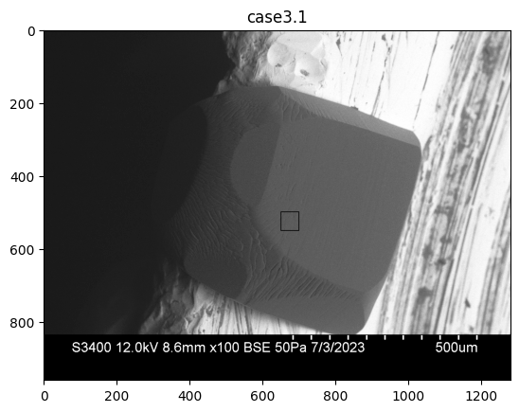
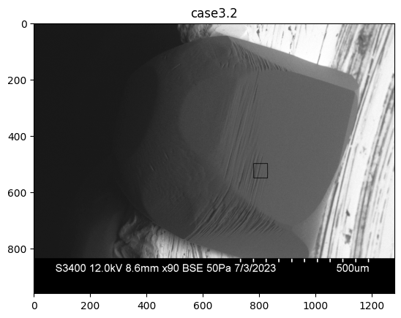
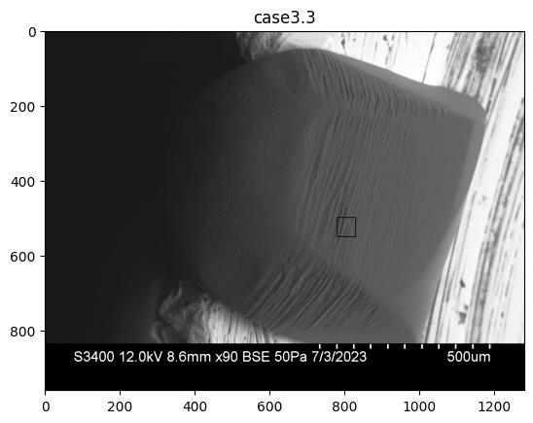
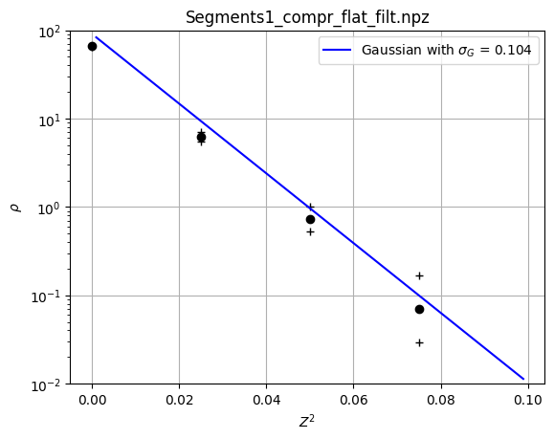
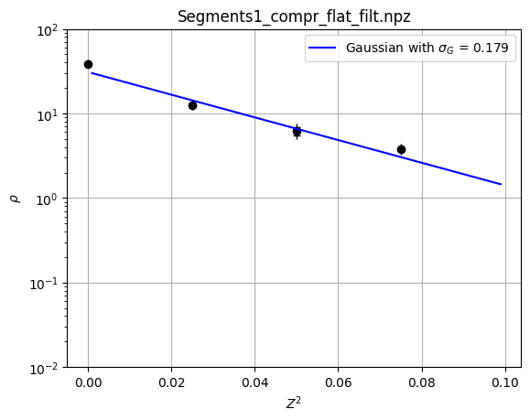
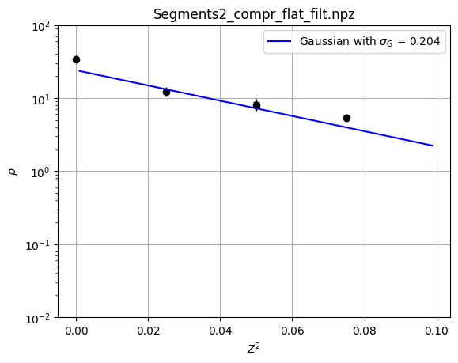
Comparing the roughness of crystals under different conditions
Temperature: -37.0º C
Pressure: 50 Pa
Temperature: -33.5º C
Pressure: 50 Pa
Temperature: -32.6º C
Pressure: 50 Pa

Slide 13
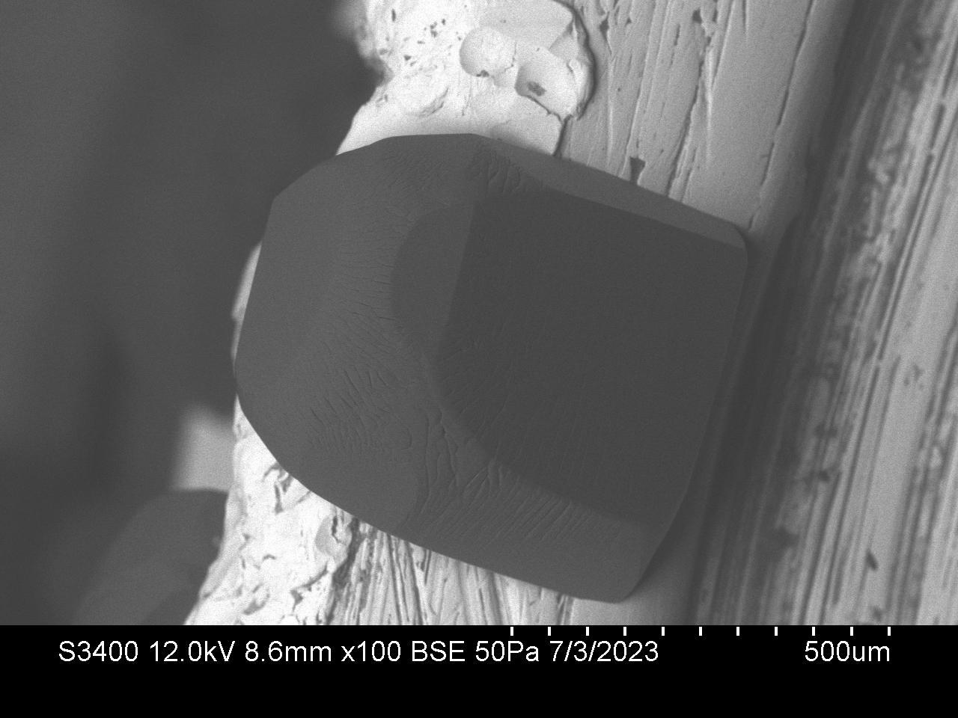
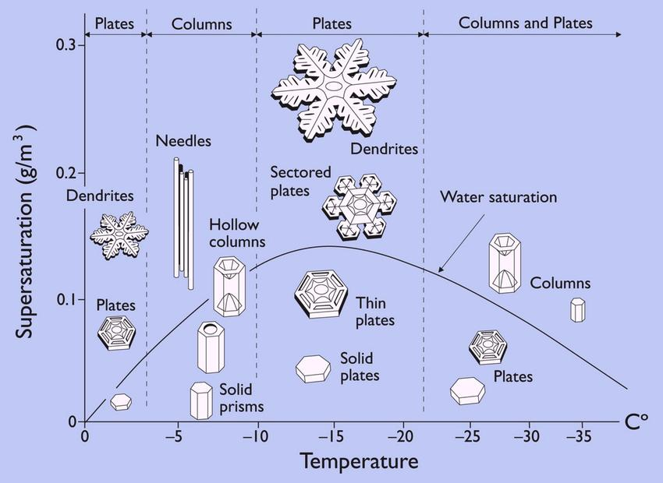
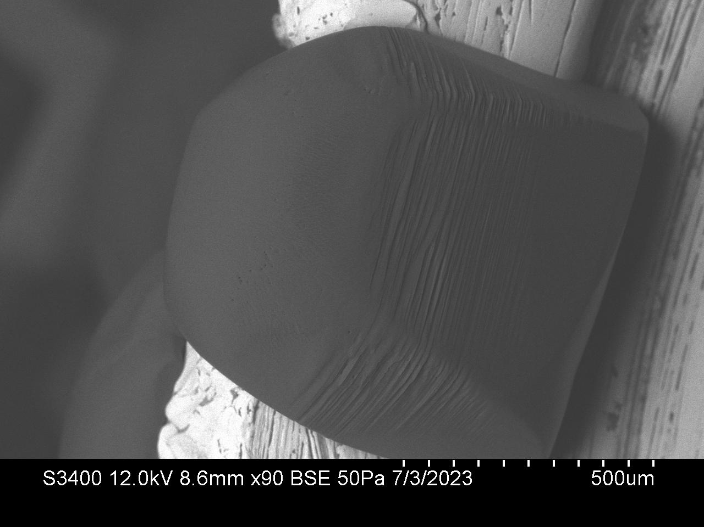
Future Directions
Higher elevation (colder)
Temp: -37.0º C
Lower elevation (warmer)
Altering pressure along with temperature in the SEM to see how roughness is affected
Using our expectations of crystal roughness to understand the properties of real cirrus clouds.
Temp: -32.6º C
Notes:
https://www.researchgate.net/figure/The-Nakaya-diagram-illustrates-which-snow-crystal-forms-appear-at-different-temperatures_fig1_221662267

Slide 14

Thank you!
National Science Foundation (1807898, 2021213)
Matelich Challenge Grant
Adam S. Goodman Endowed Student Research Fund
University Enrichment Committee
Professors Steven Neshyba and Jake Price
Researchers Spencer Racca-Gwozdzik, Ella Slattery, and Max Bloom
Amy Replogle

Slide 15
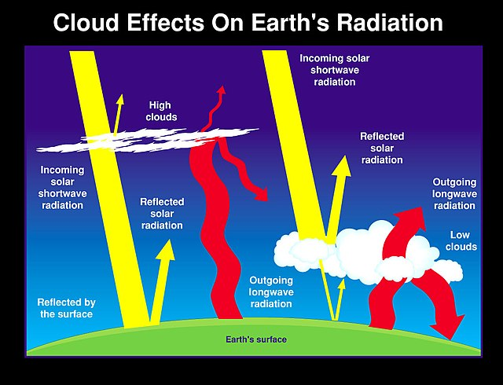

Slide 16
